Slide 1
Madeleine Leininger Culture Care Theory of Diversity and Universality
Created by:
Tammie Gillespie
Dana Kipker
Jie Li
Heather Metz

Slide 2
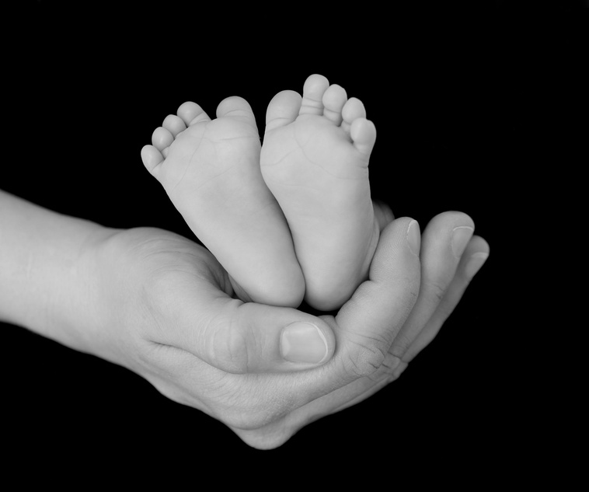
Madeleine Leininger: Birthplace
Born in Sutton Nebraska on July 13th 1925
Grew up on a farm with four brothers and sisters
Credits an aunt who suffered from congenital heart disease with going into nursing

Slide 3
Nursing Career
1945- Entered the Cadet Nurse Corps at St. Anthony’s School of Nursing in Denver, Co
Started as a floor nurse then going on to be head nurse on a busy medical-surgical floor.

Slide 4

Degrees
1948- Diploma in nursing from St. Anthony’s school of nursing
1950- Bachelors in Biological Science from Benedictine College, Atchison, Kansas
1953- MSN from Catholic University, Washington, D.C.
1965- PhD in Anthropology from University of Seattle

Slide 5

Madeleine Leininger
First nurse to hold PhD in Anthropology and Nursing
A major contributor to other schools in transcultural nursing curriculum
1966-First transcultural nursing course offered at University of Utah, Salt Lake City

Slide 6

Publishing's
1960- Transcultural Nursing: Concepts. Theories, Research, and Practice.
1985- First published her theory in Nursing Science Quarterly
1988-Further explained her theory in the same journal
1991- Culture Care Diversity and Universality: A Theory of Nursing

Slide 7
Theory’s Purpose and Goal
Purpose-to explain transcultural nursing and knowledge and practice
Goal- to identify ways to provide culturally congruent nursing care to people of diverse similar cultures

Slide 8
Logical Form
Derived from anthropology and nursing.
Reformulated to become transcultural nursing with human care perspective.
Developed the ethnonursing research method - qualitative method.
Qualitative method: ethnonursing, ethnography, life histories, life stories, photography, and phenomenological method.

Slide 9
Logical Form - continue
Why are the qualitative methods important?
  Establish meanings and accurate cultural knowledge.
  Guide nurses in their work.

Slide 10
Logical Form - continue
The essential components of Leininger theory – developed the Sunrise Enabler in the 1970s.
Has refined the sunrise to the present.
The Sunrise Enabler – human beings as inseparable from their cultural background and social structure, worldview, history, and environmental context as a basic tenet of Leininger’s theory.

Slide 11

Logical Form - continue
Leininger’s Sunrise Enabler
  Culture Care
  Worldview
  Cultural & Social Structure Dimensions
  Influences
  Focus: Individuals, Families, Groups, Communities
  Transcultural Care Decisions & Actions
  Culturally Congruent Care of Health, Well-being or Dying

Slide 12
Major Concepts
Care: “Abstract and concrete phenomena related to assisting, supporting, or enabling experiences or behaviors toward or for others with evident or anticipated needs to ameliorate or improve a human condition or lifeway”

Slide 13
Caring: “The actions and activities directed toward assisting, supporting, or enabling another individual or group with evident or anticipated needs to ameliorate or improve a human condition or lifeway or to face death.”

Slide 14
Culture: “The learned, shared, and transmitted values, beliefs, norms, and lifeways of a particular group that guide thinking, decisions, and actions in patterned ways; encompasses several cultural and social structure dimensions: technologic factors, religious and philosophical factors, kinship and social factors, political and legal factors, economic factors, educational and cultural values, and lifeways”

Slide 15
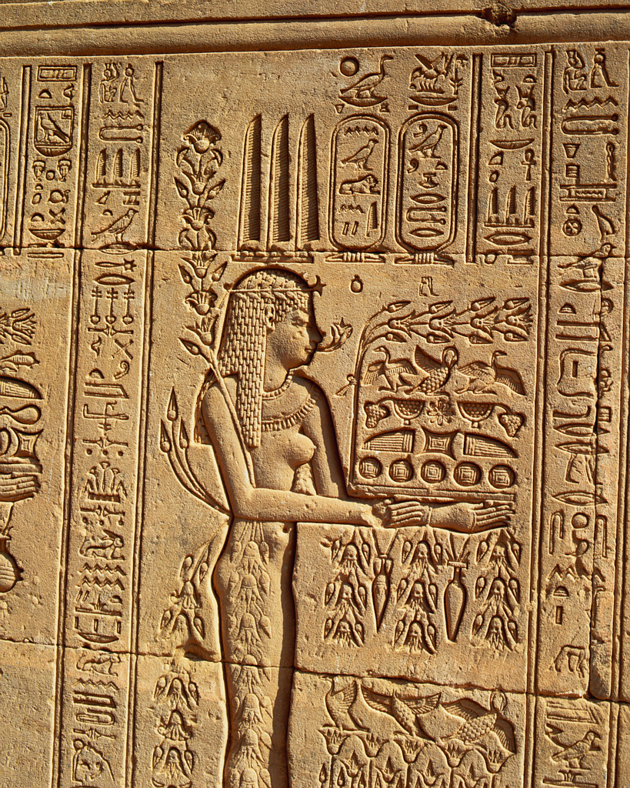

Language: “Word usages, symbols, and meanings about care”

Slide 16
Ethnohistory: “Past facts, events, instances, experiences of individuals, groups, cultures, and institutions that are primarily people-centered (ethno) and that describe, explain, and interpret human lifeways within particular cultural contexts and over short or long periods of time”

Slide 17

Environmental context: “The totality of an event, situation, or particular experience that gives meaning to human expressions, interpretations, and social interactions in particular physical, ecological, sociopolitical, and/or cultural settings”

Slide 18
Health: “A state of well-being that is culturally defined, valued, and practiced and that reflects the ability of individuals (or groups) to perform their daily role activities in culturally expressed, beneficial, and patterned lifeways”

Slide 19

Worldview: “The way people tend to look out on the world or their universe to form a picture of or a value stance about their life or the world around them”

Slide 20
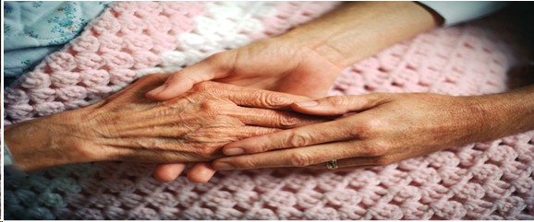
Cultural care: “The subjectively and objectively transmitted values, beliefs, and patterned lifeways that assist, support, or enable another individual or group to maintain their well-being and health, to improve their human condition and lifeway, and to deal with illness, handicaps, or death”

Slide 21
Cultural care diversity: “The variabilities and/or differences in meanings, patterns, values, lifeways, or symbols of care within or between collectivities that are related to assistive, supportive, or enabling human care expressions”

Slide 22
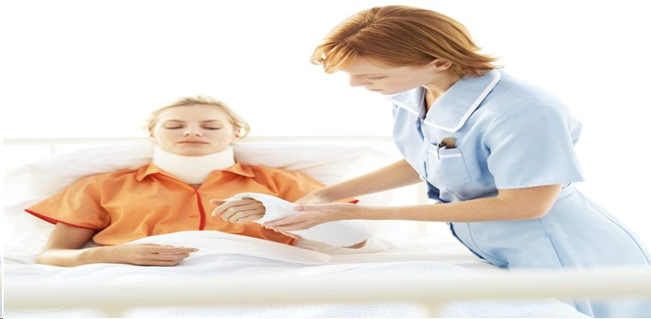
Cultural care universality: “The common, similar, or dominant uniform care meanings, patterns, values, lifeways, or symbols that are manifest among many cultures and reflect assistive, supportive, facilitative, or enabling ways to help people”

Slide 23

Care systems: “The values, norms, and structural features of an organization designed for serving people’s health needs, concerns, or conditions”

Slide 24
Generic lay care system: “Traditional or local indigenous health-care or cure practices that have special meanings and uses to heal or assist people, which are generally offered in familiar home or community environmental contexts with their local practitioners”

Slide 25

Professional health-care system: “Professional care or cure services offered by diverse health personnel who have been prepared through formal professional programs of study in special educational institutions”

Slide 26
Cultural-congruent nursing care: “Cognitively based assistive, supportive, facilitative, or enabling acts or decisions that are tailor-made to fit with individual, group, or institutional cultural values, beliefs, and lifeways in order to provide or support meaningful, beneficial, and satisfying health-care or well-being services”

Slide 27
Cultural care preservation or maintenance: “Assistive, supportive, facilitative, or enabling professional actions and decisions that help people of a particular culture retain and/or preserve relevant care values so that they can maintain their well-being, recover from illness, or face handicaps and/or death”

Slide 28
Cultural care accommodation or negotiation: “Assistive, supportive, facilitative, or enabling creative professional actions and decisions that help people of a designated culture adapt to, or negotiate with, others for a beneficial or satisfying health outcome with professional care providers”

Slide 29
Cultural care repatterning or restructuring: “Assistive, supportive, facilitative, or enabling professional actions and decisions that help clients reorder, change, or greatly modify their lifeways for a new, different, and beneficial health-care pattern while respecting the clients' cultural values and beliefs and still providing a beneficial or healthier lifeway than before the changes were coestablished with the clients”

Slide 30
Acceptance By Nursing Community (Practice)
Factors that delayed progression & acceptance
Conceptualized during the 1950s
Clients didn’t demand cultural needs be met
Publications rejected by editors due to lack of understanding the basis of the theory
Nurses not interested in the theory
Nurse researcher’s us quantitative rather that qualitative research methods

Slide 31
Acceptance by the Nursing Community (Addition)
Several factors that delayed acceptance in nursing practices and education.
Nurses have no knowledge of the relevance of anthropology and health care.
Clients did not demand that their cultural needs to be recognized.
Transcultural nursing articles were rejected by the publication in the past decade.
Nurses were not interested in the concepts of cultural care in the late 1970s.

Slide 32

Acceptance by the Nursing Community (Addition)
Nursing tends to remain to ethnocentric.
Nursing has been slow to make substantive progress in the development of a distinct body of knowledge.
The world becomes more culturally diverse.

Slide 33
1991 to Present
Currently more nurse researcher’s have adapted to using qualitative research methods
With the United States becoming more diverse, nurses are beginning to realize that understanding culture is significant in order to provide quality care.

Slide 34
Education
Culture care began in 1966 at University of Colorado
First master’s and doctoral programs in culture care began in 1977, at the University of Utah
In the 1970s, Cuesta College in California, developed first undergraduate program.
Demand is high for transcultural nurses, although resources are limited

Slide 35
Research
Over 100 cultures and subcultures have been analyzed since 1995
Limited schools in the United States receive federal funding to study this theory
Some professors at the graduate level will not let students research this theory because of their (professors) lack of understanding regarding transcultural nursing

Slide 36
Research (continued)
In the 1990s, national and international organizations began to support the concept of transcultural nursing
Transcultural nurses share their research with other nurses at conventions with the hope that more nurses will become interested in this theory.

Slide 37
Scenario
You are assigned a patient that is a 98y.o. female who lives by herself. She is being admitted with a GI Bleed. Patient has a history of hypertension. Her granddaughter is with her at the bedside. The patient only speaks Latvian. Her granddaughter speaks both. The patient is currently being prepped for a EGD and Colonoscopy to be preformed in the morning. Using Leininger Model how would you care for this patient? Is there any barriers that you can foresee? How will you communicate with the patient? How will you know the patient understands?

Slide 38
References
Kearney-Nunnery, R. (2008), pp. 74-75. Advancing Your Career Concepts of Professional Nursing (4th ed.). Philadelphia: FA Davis.
Marriner Tomey, A., & Raile Alligood, M. (2006), pp. 101-104. Nursing Theorist and Their Work (6th ed.). St. Louis: Mosby Elsevier.

Slide 39
Websites
WWW.CONTEMPORARYNURSE.COM
WWW.MADELEINE-LEININGER.COM
WWW.CULTUREDIVERSITY.ORG

Slide 40
Degrees and Titles
PhD-Doctor of Philosophy
LHD-Doctor of Human Sciences
DS-Doctor of Science
RN-Registered Nurse
CTN-Certified Transcultural Nurse
FRCNA-Fellow of the Royal College of Nursing in Australia
FAAN-Fellow American Academy of Nursing

